Slide 1
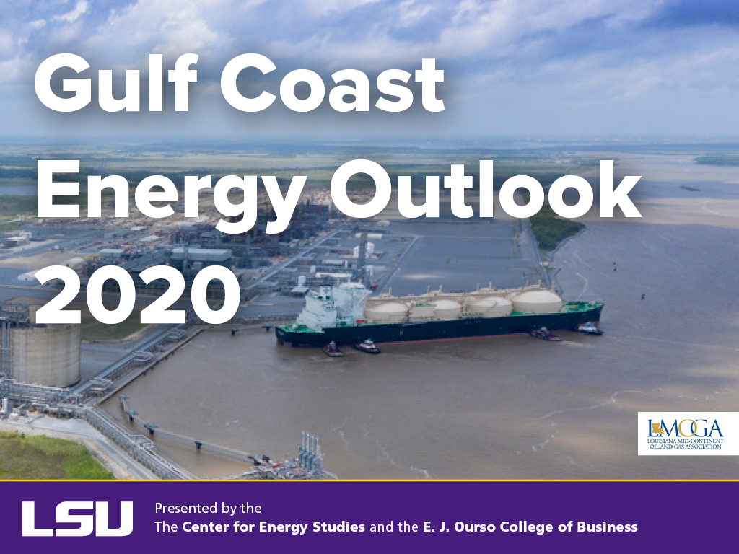

Slide 2
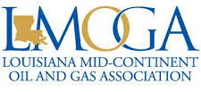






Introduction
Gulf Coast Energy Outlook
Platinum
Gold
This outlook would not be possible without feedback from stakeholders from across the energy industry.
While “crunching the numbers” is a critical part of any synopsis report such as this one, equally as important is input from stakeholders who have an “on-the-ground” view of what is occurring in real time.
Thank you!
Silver
Bronze
Contributor
© LSU Center for Energy Studies
Notes:
Thank students: Drew, Jenna, Caroline, and Preston.
Highlights: Between David and I, we’ve presented at over 15 local industry groups to over 1,000 people.
The GCEO was downloaded more than 4,000 times from CES website.

Slide 3
Upstream Oil and Gas Outlook
© LSU Center for Energy Studies

Slide 4
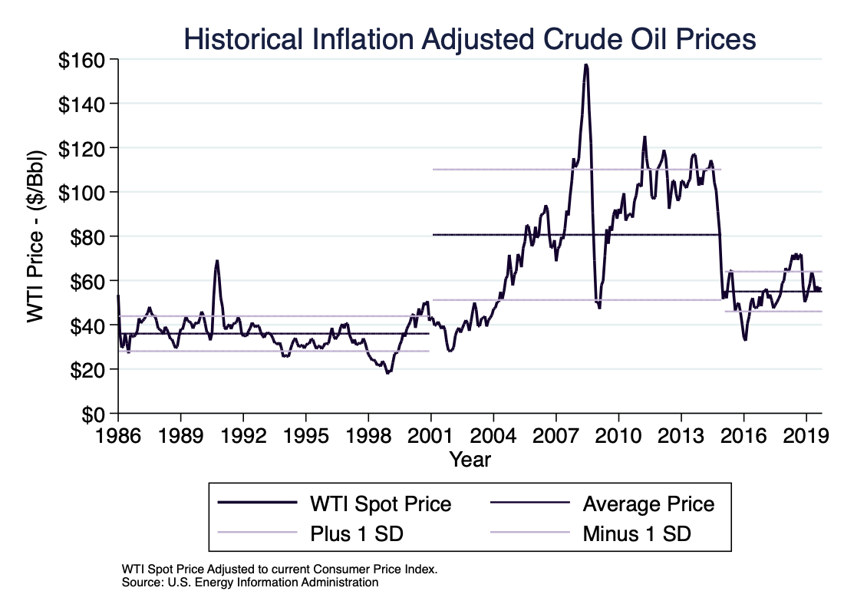
© LSU Center for Energy Studies

Slide 5
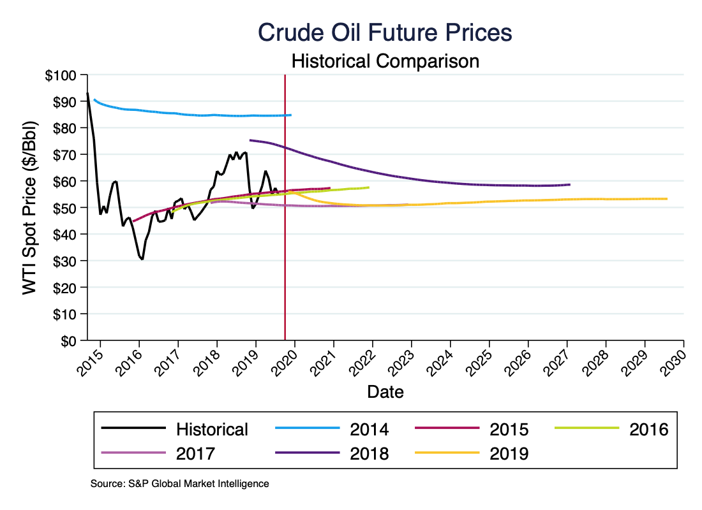
© LSU Center for Energy Studies

Slide 6
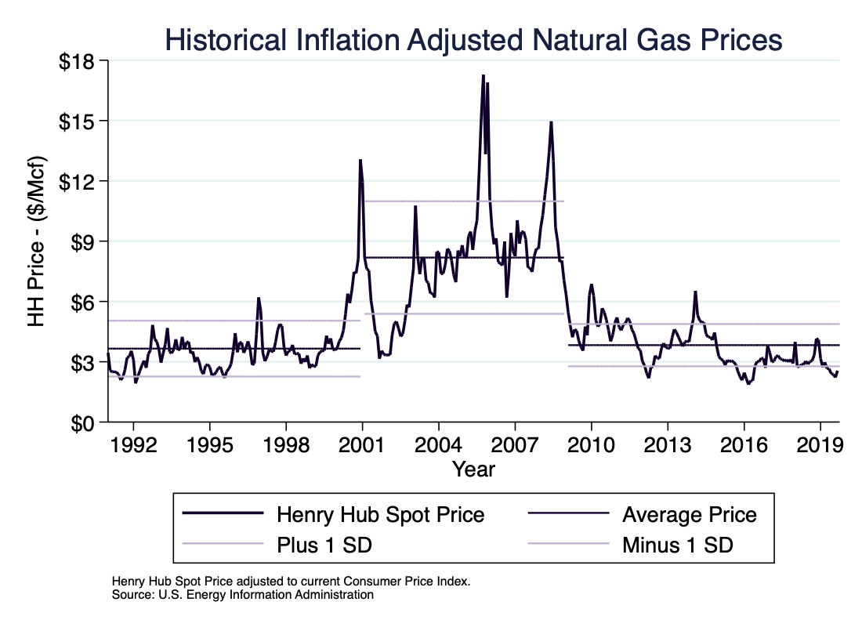
© LSU Center for Energy Studies

Slide 7
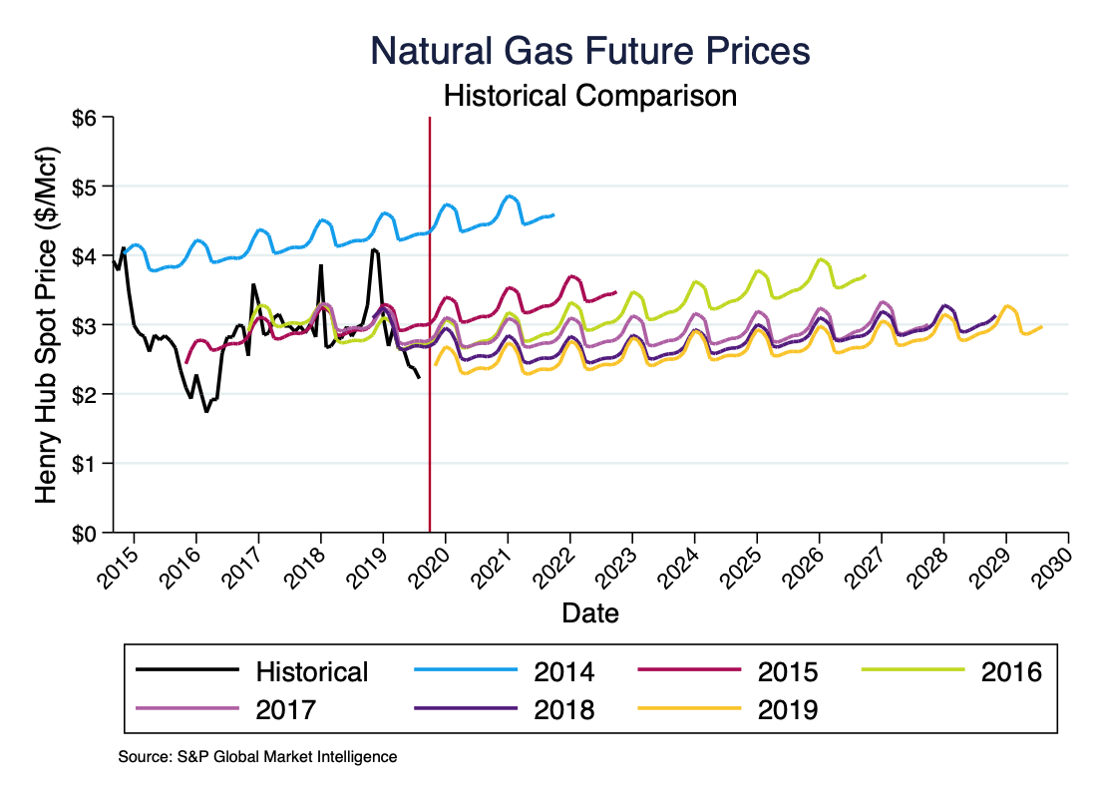
© LSU Center for Energy Studies

Slide 8
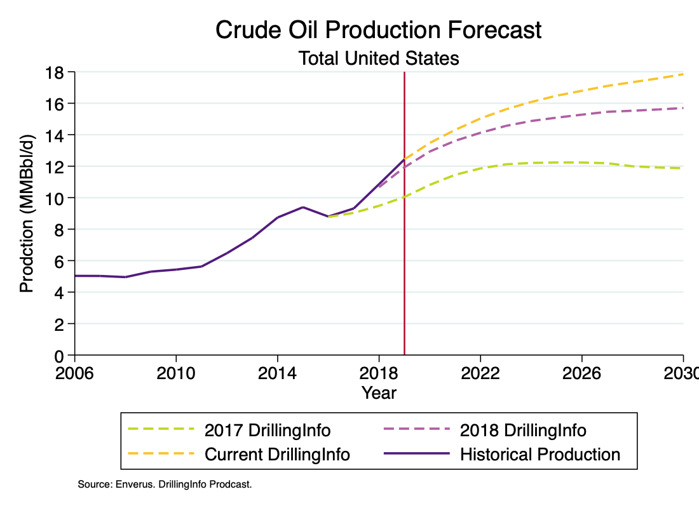
© LSU Center for Energy Studies

Slide 9
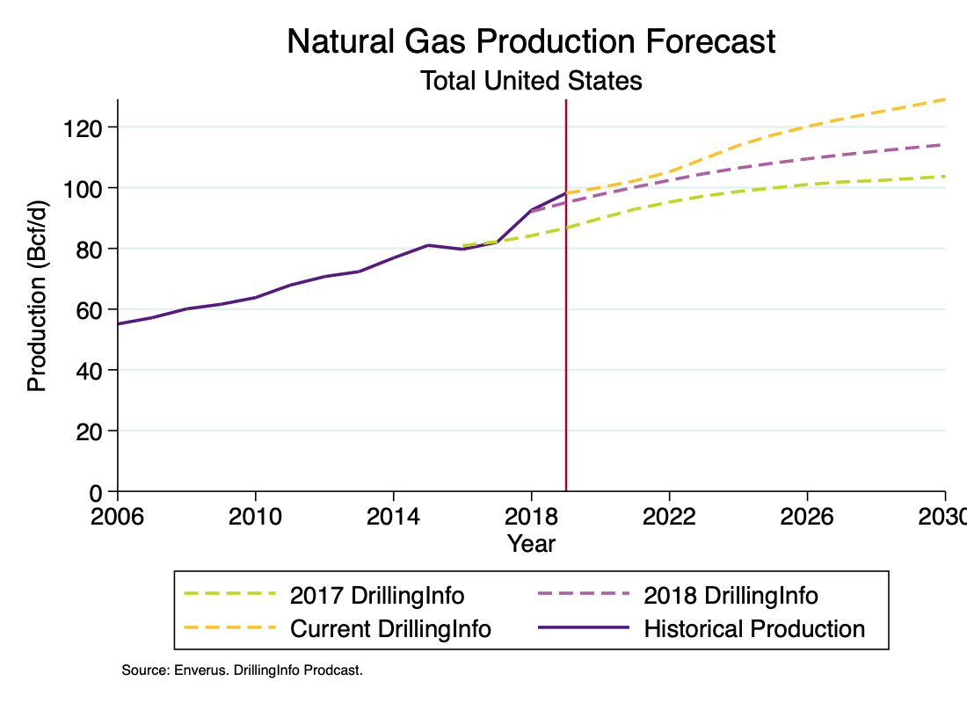
© LSU Center for Energy Studies

Slide 10
Industrial Development - Trends
© LSU Center for Energy Studies

Slide 11
Industrial Development
GOM energy manufacturing investments by state.
The continued low natural gas price outlook has facilitated considerable development of almost $308 billion: $113 billion already completed (through 2018) and $195 billion remaining, but heavily concentrated in LNG export facilities.
Billion $
Source: David E. Dismukes (2013). Unconventional Resources and Louisiana’s Manufacturing Development Renaissance. Baton Rouge, LA: Louisiana State University, Center for Energy Studies and author’s updates.
© LSU Center for Energy Studies

Slide 12
Industrial Development
GOM energy manufacturing investments by sector.
Prior to 2019, LNG investments accounted for $55 billion (45 percent) of all capital investments along the Gulf Coast. Olefins (cracker) and other petrochemical-based investments accounted for $43 billion (38 percent).
Billion $
Source: David E. Dismukes (2013). Unconventional Resources and Louisiana’s Manufacturing Development Renaissance. Baton Rouge, LA: Louisiana State University, Center for Energy Studies and author’s updates.
© LSU Center for Energy Studies

Slide 13
Industrial Development
Total GOM investment, all project announcements.
Texas total investment = $70.6 billion; Louisiana total investment = $116.3 billion; Total GOM investment = $194.9 billion – assuming all projects are developed at anticipated cost and at anticipated schedule.
Good news/bad news: Louisiana announced investment is larger than Texas – but -- Louisiana announcements are heavily weighted towards LNG.
© LSU Center for Energy Studies

Slide 14
Employment Forecast
© LSU Center for Energy Studies

Slide 15
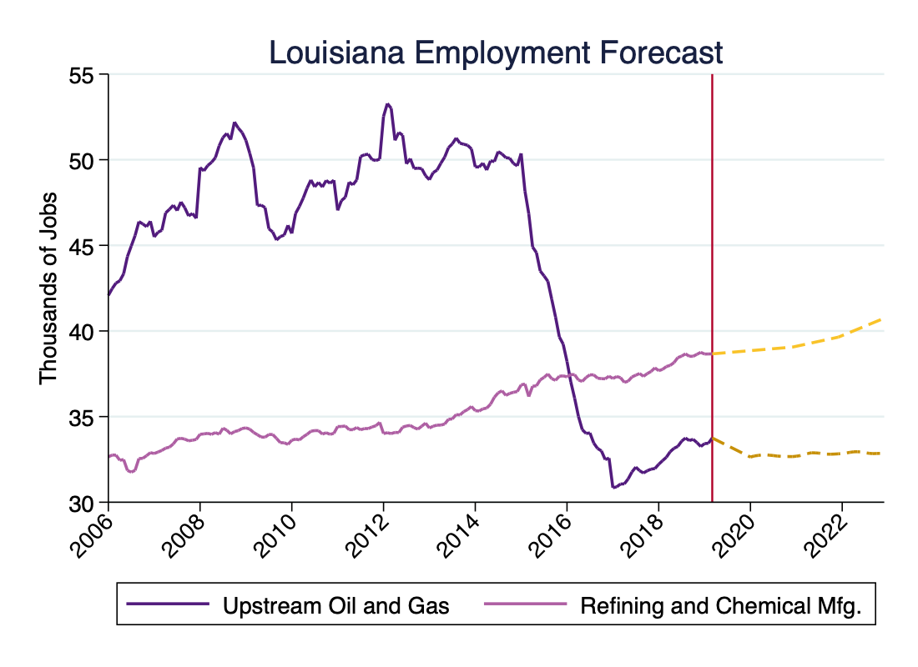
Employment Forecast
© LSU Center for Energy Studies

Slide 16
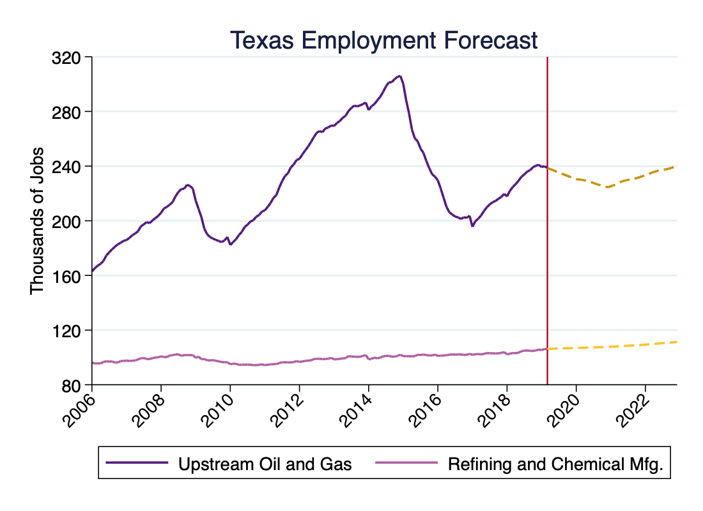
Employment Forecast
© LSU Center for Energy Studies

